Slide 1
Lecture Notes: Sharpening and Edge Enhancement

Slide 2
Sharpening
Results from high frequency enhancement since small features correspond to short wavelength sinusoids.
Relative amplification of high frequencies in the Fourier domain corresponds to differentiation in the spatial domain.
On a discrete image, differentiation corresponds to pixel differencing.

Slide 3
The Derivative Property of the Fourier Transform
The FT of the partial derivative w.r.t. r (in the row direction) of an image, I …
Integration by parts
… is equal to the product of the FT of the image and the corresponding frequency variable, v.
This results in horizontal HF enhancement

Slide 4
Differentiation is Highpass Filtering
Directional derivative in c.
Vertical HF Enhancement
Directional derivative in r.
Horizontal HF Enhancement

Slide 5
Fourier Transforms of Sums of Derivatives
Sum of first-order partial derivatives…
…linear amplification of high frequencies
Sum of second-order partial derivatives…
…quadratic amplification of high frequencies

Slide 6
Sharpening via Differencing or Highpass Filtering
Sharpening results from adding to the image a copy of itself that has been:
Pixel-differenced in the spatial domain:
Each pixel in the output is a difference between itself and a weighted average of its neighbors.
Is a convolution whose weight matrix sums to 0.
Highpass filtered in the frequency domain:
High frequencies are enhanced or amplified.
Individual frequency components are multiplied by an increasing function of ω such as αω = α√(u²+v²), where α is a constant.

Slide 7
Horizontal Differences
255
Image
0
-255
Left (back)
Difference
Right (fwd)
Difference
Sum of
Differences

Slide 8


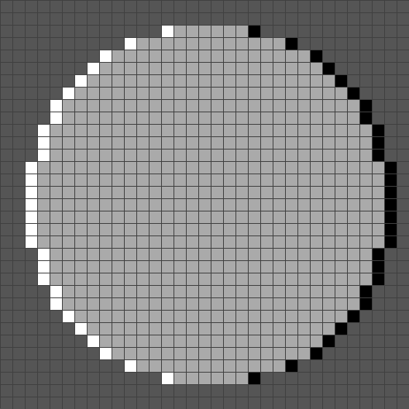
Horizontal Differencing / Sharpening
original: I(r,c)
upward diff: I(r,c)-I(r-1,c)
sharpened: 2I(r,c)-I(r-1,c)

Slide 9
Horizontal Differencing / Sharpening
original: I(r,c)
downward diff: I(r,c)-I(r+1,c)
sharpened: 2I(r,c)-I(r+1,c)

Slide 10


Horizontal Differencing / Sharpening
original: I(r,c)
2I(r,c)-I(r-1,c)-I(r+1,c)
3I(r,c)-I(r-1,c)-I(r+1,c)

Slide 11
Vertical Differencing / Sharpening
original: I(r,c)
backward diff: I(r,c)-I(r,c-1)
sharpened: 2I(r,c)-I(r,c-1)

Slide 12
Vertical Differencing / Sharpening
original: I(r,c)
forward diff: I(r,c)-I(r,c+1)
sharpened: 2I(r,c)-I(r,c+1)

Slide 13


Vertical Sharpening
original: I(r,c)
2I(r,c)-I(r,c-1)-I(r,c+1)
3I(r,c)-I(r,c-1)-I(r,c+1)

Slide 14


Horizontal + Vertical Sharpening
original: I(r,c)
4I(r,c)-I(r,c+1)-I(r,c-1)-I(r+1,c)-I(r-1,c)
5I(r,c)-I(r,c+1)-I(r,c-1)-I(r+1,c)-I(r-1,c)

Slide 15

Perceptual Note
That our visual system does something like the edge enhancement of the disk on the left is strongly suggested by the appearance of the disk on the right. It contains only 2 intensity levels. But, we see 4 – the background, the disk, and concentric dark and bright circles surrounding the disk.
5I(r,c)-I(r,c+1)-I(r,c-1)-I(r+1,c)-I(r-1,c)
a two-level image: I(r,c) ∈{64,192}

Slide 16


Differencing / Highpass Filtering
original image, I
power spectrum

Slide 17


Differencing / Highpass Filtering
power spectrum of h = [-1 1 0]
power spectrum of I∗h = I(r,c)-I(r,c+1)

Slide 18

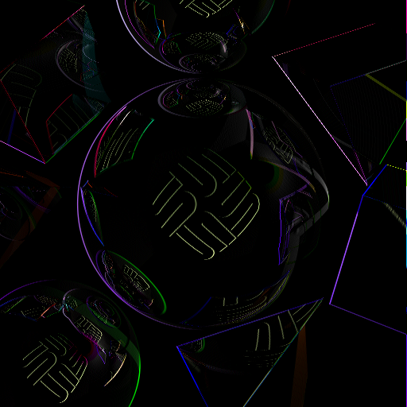
Differencing / Highpass Filtering
negative pixels in differenced image
positive pixels in differenced image

Slide 19
Differencing / Highpass Filtering
original image, I
power spectrum

Slide 20
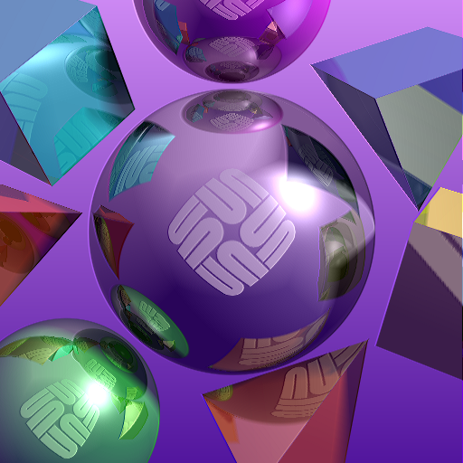

Image Sharpening
Add the differenced image, I(r,c)-I(r,c+1), back to the original to get a HF enhanced version. It is a “sharper” version of the original.
sharpened image, 2I(r,c)-I(r,c+1)
power spectrum

Slide 21
Image Sharpening
original image, I
power spectrum

Slide 22
Image Sharpening
Note the apparent shift to the right of the sharpened image.
sharpened image, 2I(r,c)-I(r,c+1)
power spectrum

Slide 23
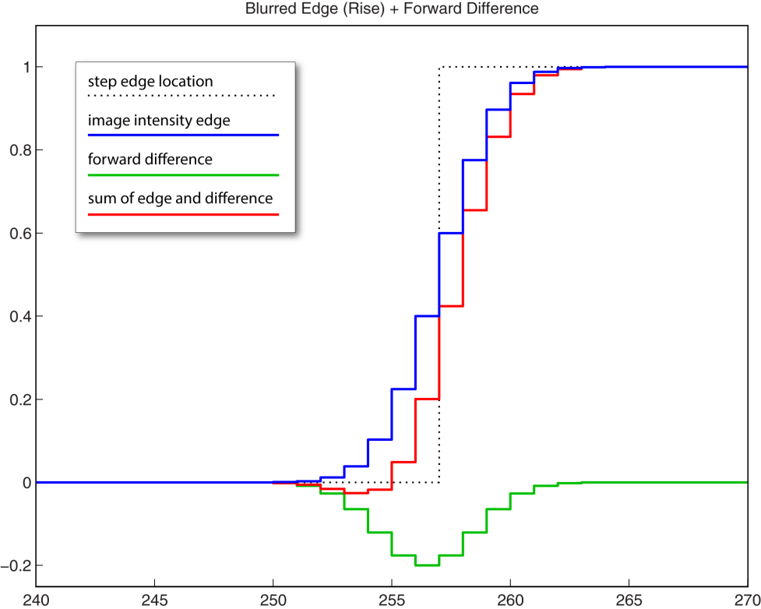
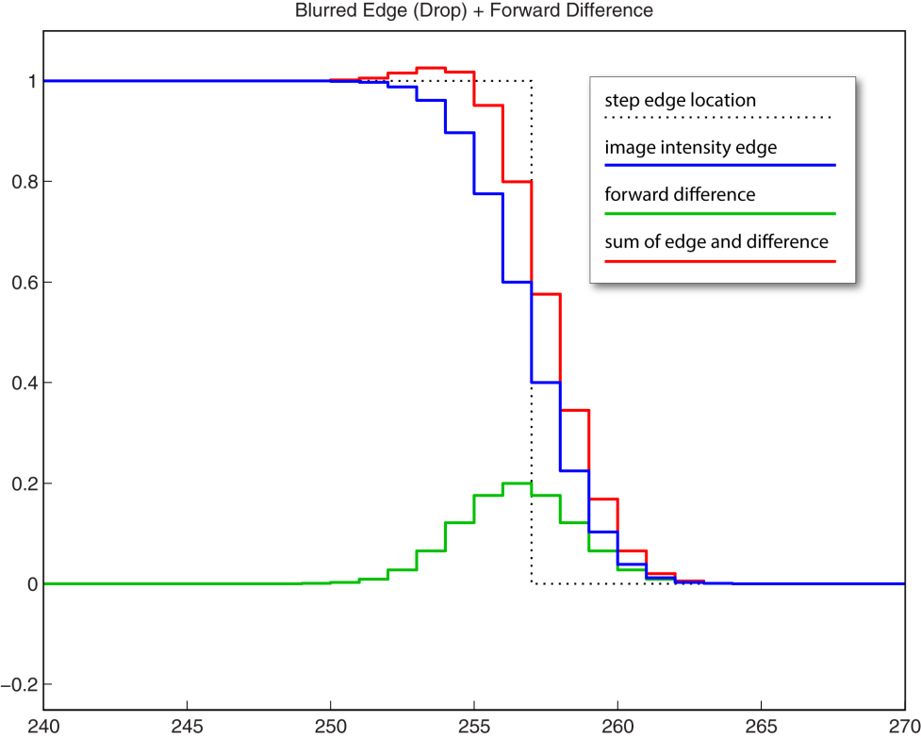
Image Sharpening: Edge Enhancement
Adding a differenced image back to the original increases the high frequency content. It steepens the slopes of the edges which makes the image look “sharper.” Note also that a forward difference, I(r,c)-I(r,c+1), causes the apparent edge to shift to the right.

Slide 24
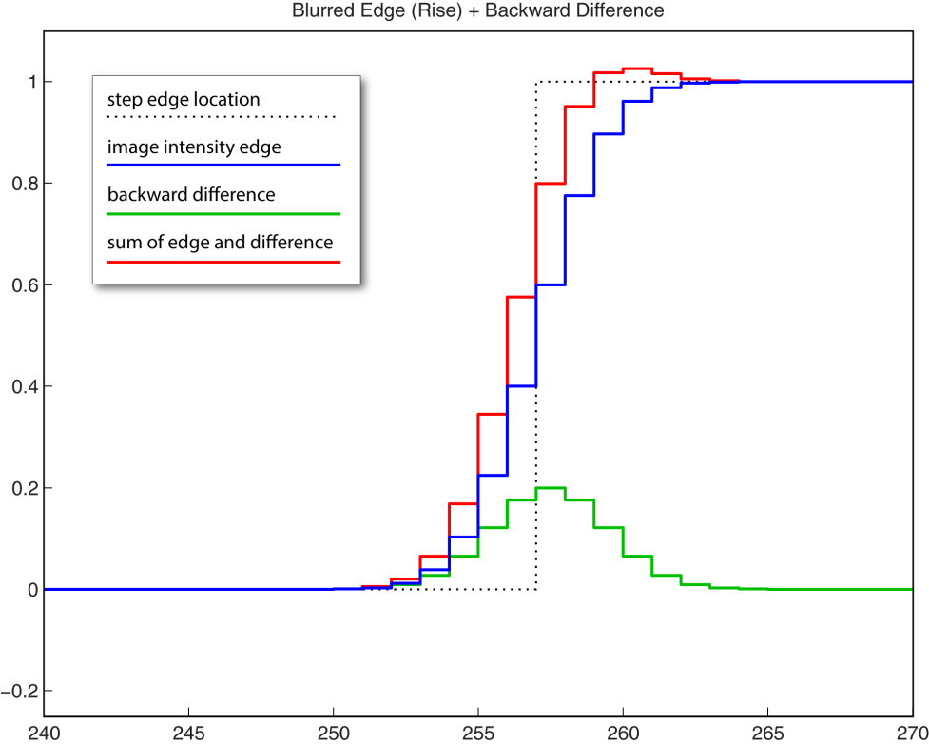
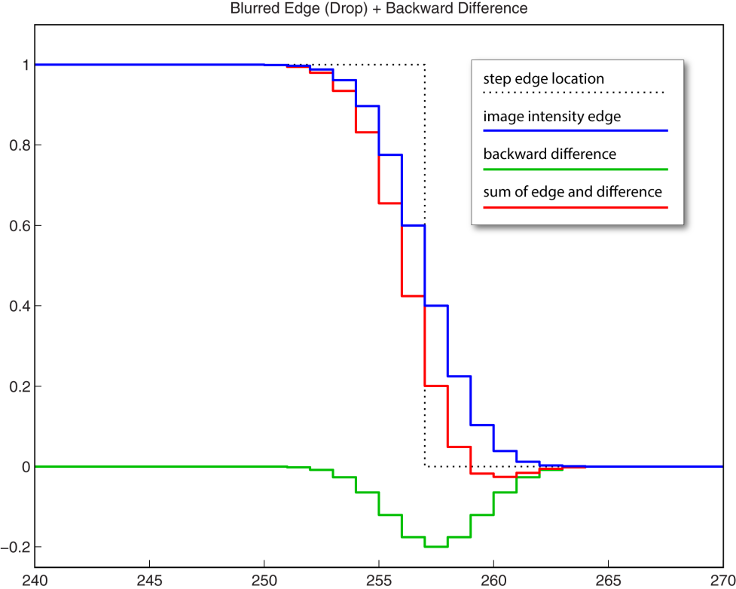
Image Sharpening: Edge Enhancement
Adding a differenced image back to the original increases the high frequency content. It steepens the slopes of the edges which makes the image look “sharper.” Note also that a backward difference, I(r,c)-I(r,c-1), causes the apparent edge to shift to the left.

Slide 25
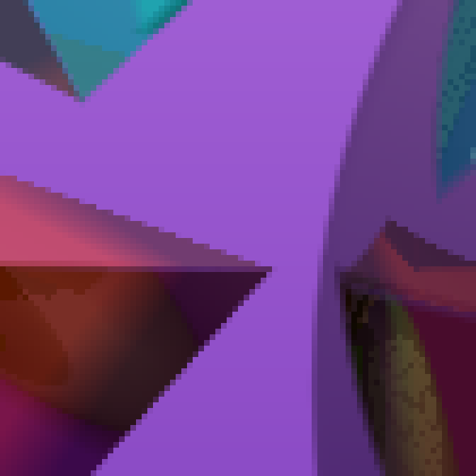
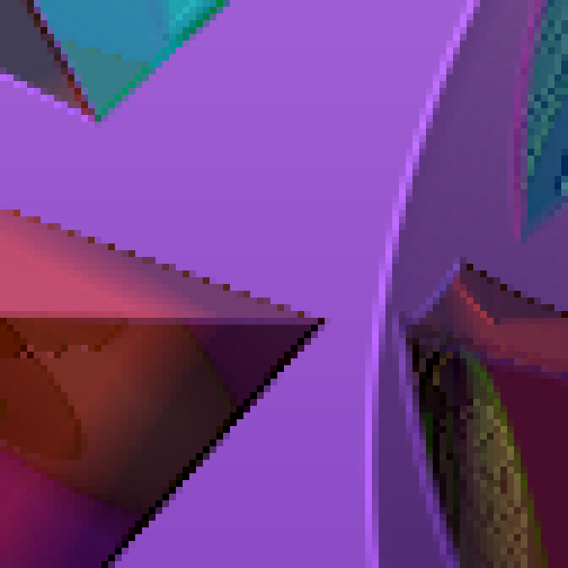
Sharpening: Differencing / Highpass Filtering
The shift occurs because the direction of the differencing operation pushes edges in the same direction.
original image
sharpened image, 2I(r,c)-I(r,c-1)

Slide 26
Sharpening: Differencing / Highpass Filtering
The shift occurs because the direction of the differencing operation pushes edges in the same direction. (see pp.7-8)
sharpened image, 2I(r,c)-I(r,c-1)
original image

Slide 27
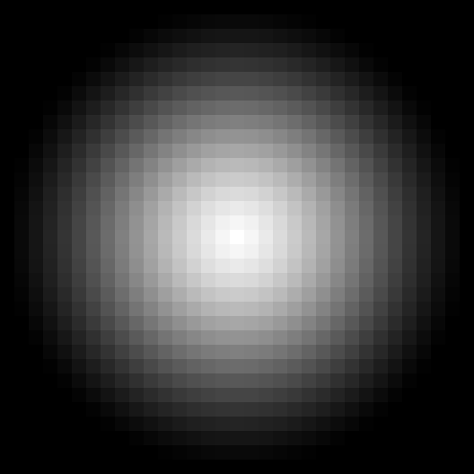
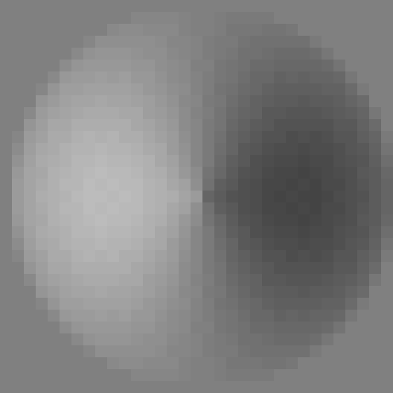
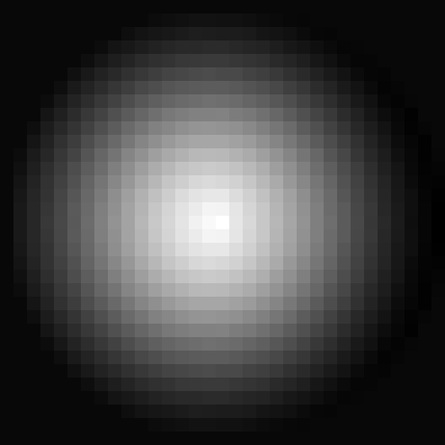
Apparent Shift due to HF Enhancement
original
backward diff: I(r,c)-I(r,c-1)
enhanced: 2I(r,c)-I(r,c-1)

Slide 28
Apparent Shift due to HF Enhancement
enhanced: 2I(r,c)-I(r,c-1)
backward diff: I(r,c)-I(r,c-1)
original

Slide 29
Differentiation Through Integration
1.
Assume that h(ρ,χ) = δ(ρ,χ). Then I∗h = I. and ∂I/∂w = ∂(I∗h)/∂w.
Differentiation property of the Fourier Transform.
2.
Convolution property of the Fourier Transform.
3.
∂/∂w is a directional derivative with direction vector [α β]^{T}.

Slide 30
Differentiation Through Integration
Apply 2 and 3 to 1 to get 4 & 5.
4.
[α β]^{T} is a direction in the plane. w and z are projections along that direction.
The derivative of a convolution of I by h is the convolution of I by the derivative of h.
5.

Slide 31
Symmetric Differences
510
-1
-1
255
2
-1
4
-1
-1
2
-1
0
-1
-1
-255
legend
convolution matrices

Slide 32
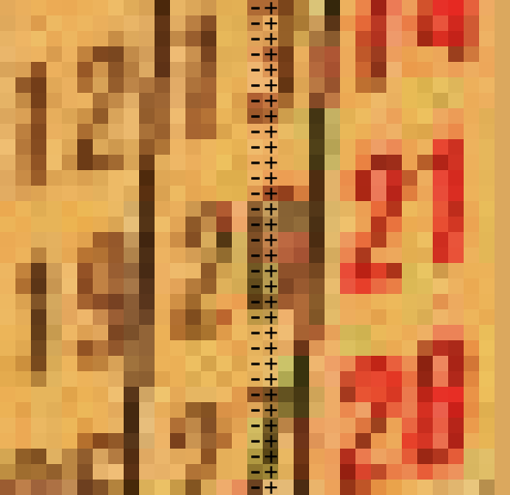
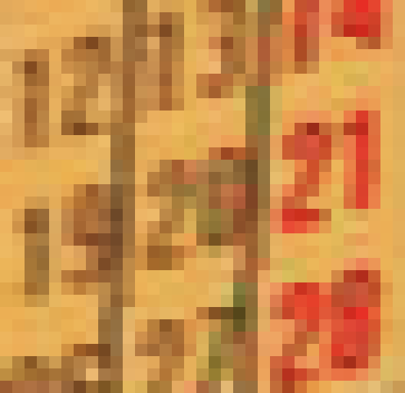
A note on FBUD* differences & convolution
A backward difference on I is the same as
right shifting a copy of I by one pixel and subtracting it from I.
*forward, backward, up, down

Slide 33
A note on FBUD* differences & convolution
That is, to compute I(r₀,c)-I(r₀,c-1) …
… convolve I with h=[0 1 -1].
A backward difference is the same as…
… right shifting a copy and subtracting it.
h_{b}=[0 1 -1] is a backward difference whereas h_{f}=[-1 1 0] is a forward difference.
*forward, backward, up, down

Slide 34

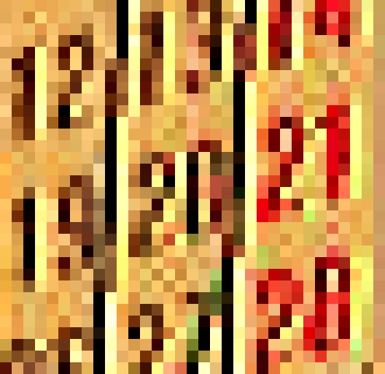
A note on FBUD* differences & convolution
backward diff: I(r,c)-I(r,c-1)
enhanced: 2I(r,c)-I(r,c-1)
*forward, backward, up, down

Slide 35
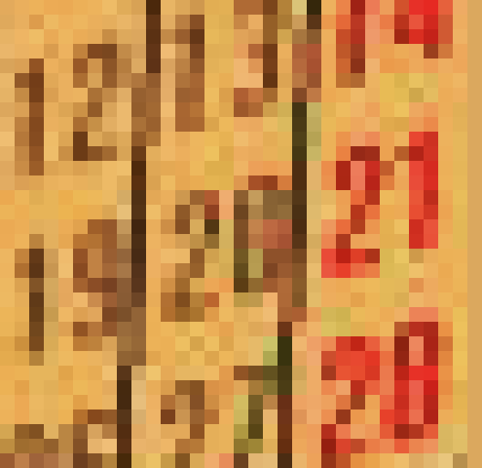
A note on FBUD* differences & convolution
enhanced: 2I(r,c)-I(r,c-1)
original
*forward, backward, up, down

Slide 36
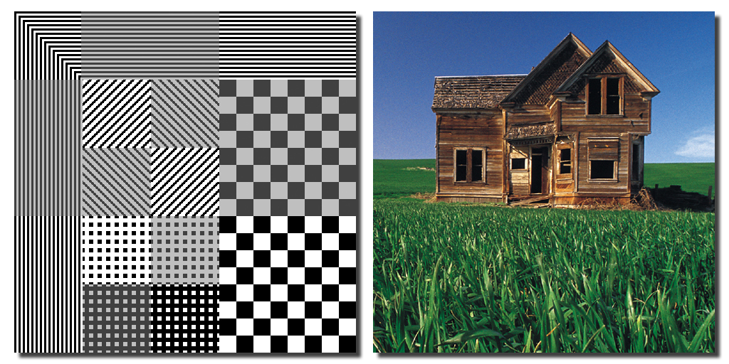
Convolution Examples: Original Images

Slide 37
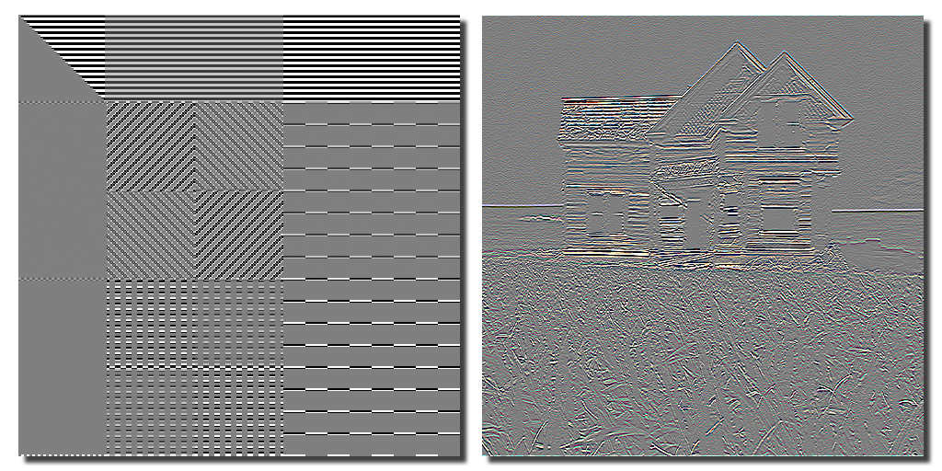
Convolution Examples: Vertical Difference
signed image; 0 is middle gray

Slide 38
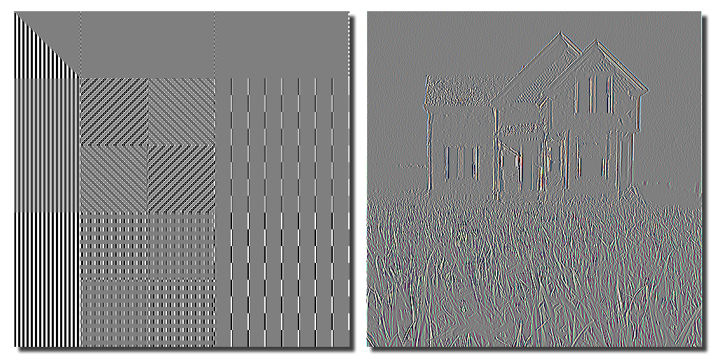
Convolution Examples: Horizontal Difference
signed image; 0 is middle gray

Slide 39
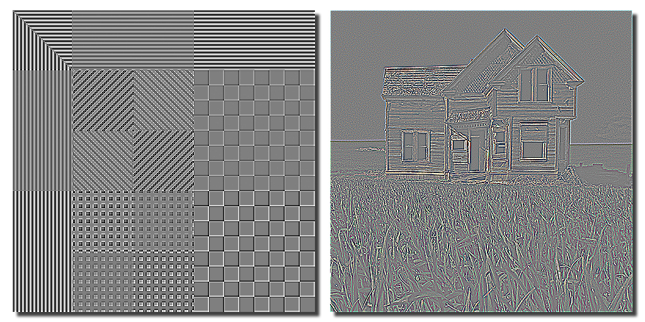
Convolution Examples: H + V Diff.
signed image; 0 is middle gray

Slide 40
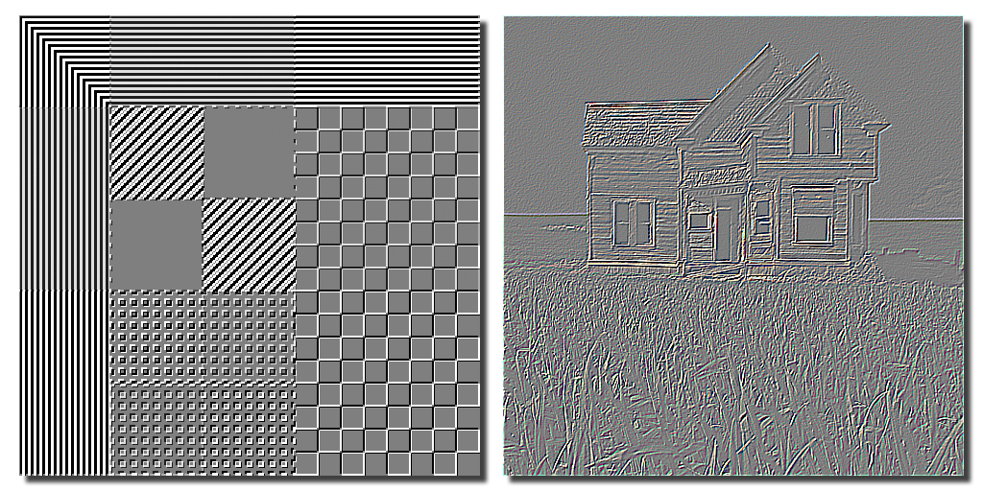
Convolution Examples: Diagonal Difference
signed image; 0 is middle gray

Slide 41
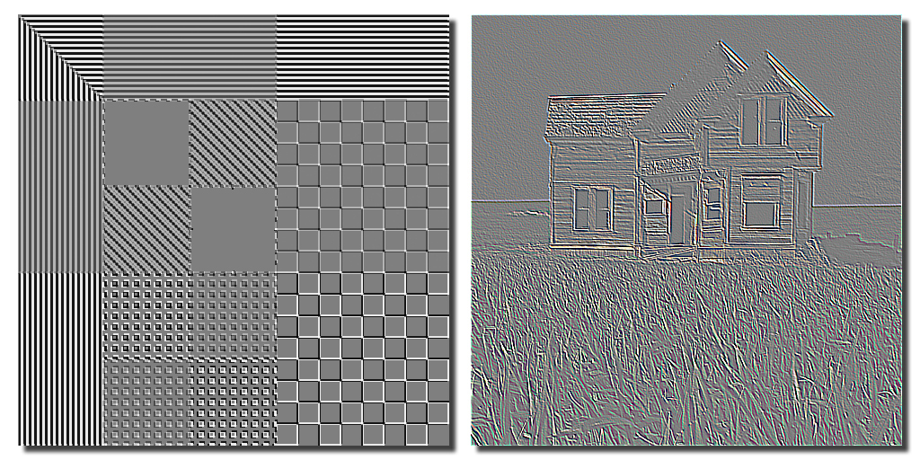
Convolution Examples: Diagonal Difference
signed image; 0 is middle gray

Slide 42
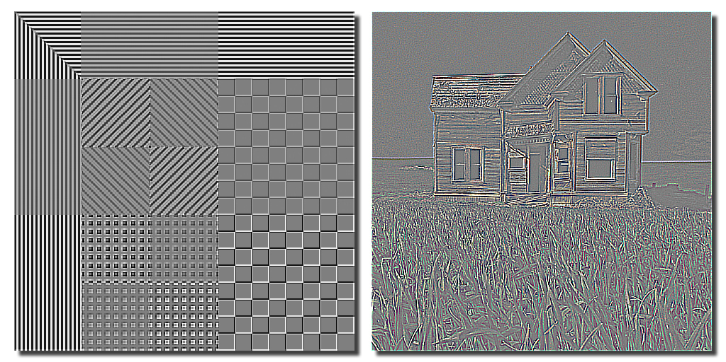
Convolution Examples: D + D Difference
signed image; 0 is middle gray

Slide 43
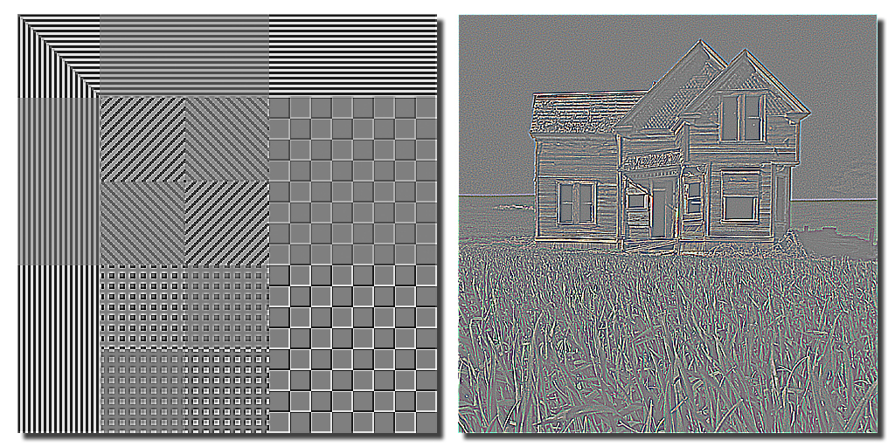
Convolution Examples: H + V + D Diff.
signed image; 0 is middle gray

Slide 44
Convolution Examples: Original Images

Slide 45
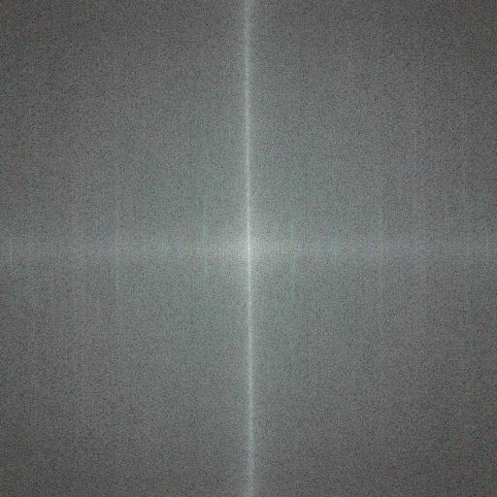
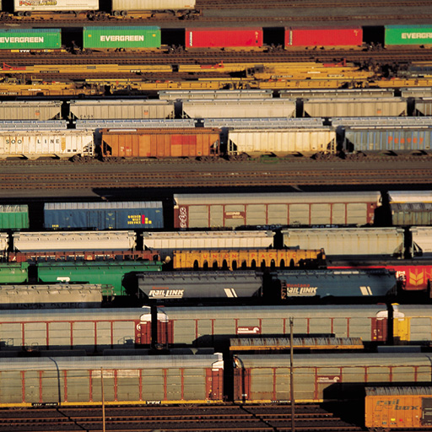
Original Image
power spectrum of I
image I

Slide 46

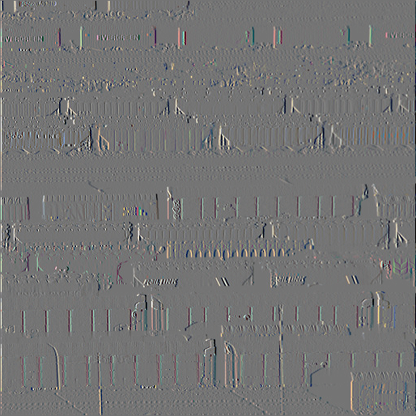
Left Difference
power spectrum of I∗h = I∗[-1 1 0]
I∗h = I∗[0 1 -1]

Slide 47
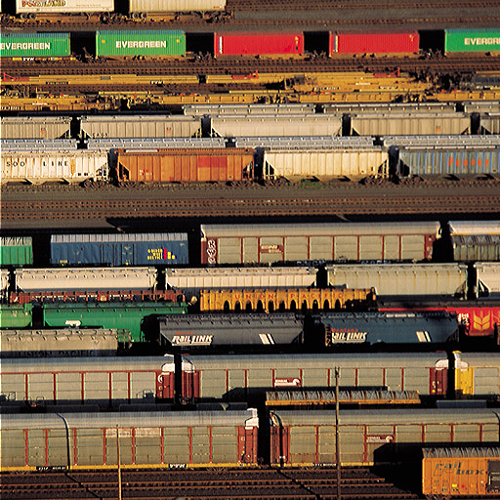
Original Image + Left Difference
image I
I+(I∗h) = I+(I∗[0 1 -1])

Slide 48
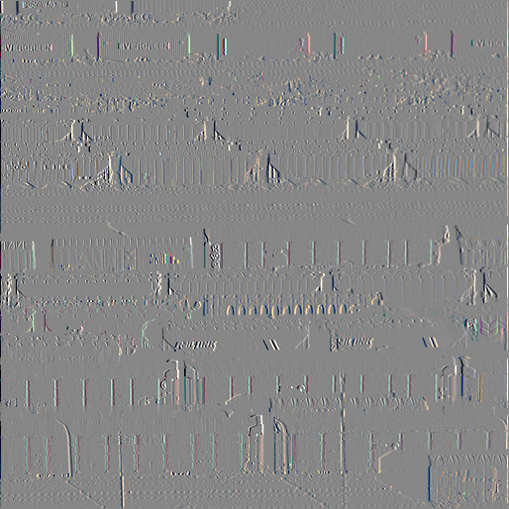
Right Difference
power spectrum of I∗h = I∗[1 -1]
I∗h = I∗[-1 1 0]

Slide 49

Original Image + Right Difference
image I
I+(I∗h) = I+(I∗[-1 1 0])

Slide 50


Vertical Edges (L+R Diffs)
power spectrum of I∗h = I∗[-1 2 -1]
I∗h = I∗[-1 2 -1]

Slide 51

Original Image + Vertical Edges
image I
I+(I∗h) = I+(I∗[-1 2 -1])

Slide 52

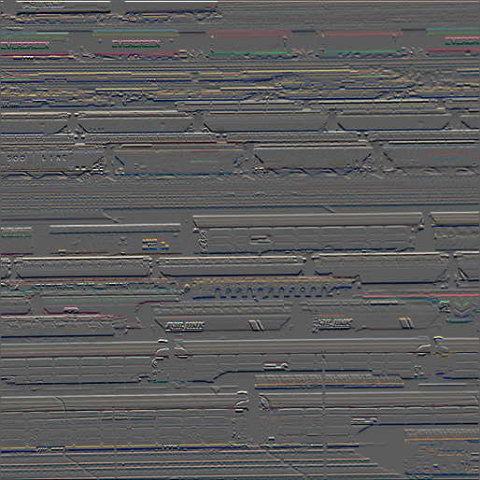
Down Difference
power spectrum of I∗h = I∗
I∗h = I∗

Slide 53
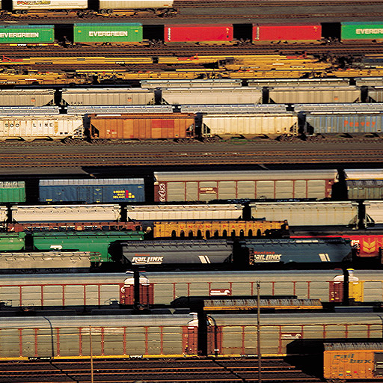
Original Image + Down Difference
image I
I+(I∗h) = I+( I∗ )

Slide 54
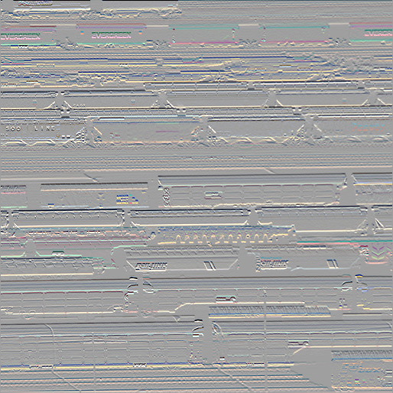
Up Difference
power spectrum of I∗h = I∗
I∗h = I∗

Slide 55
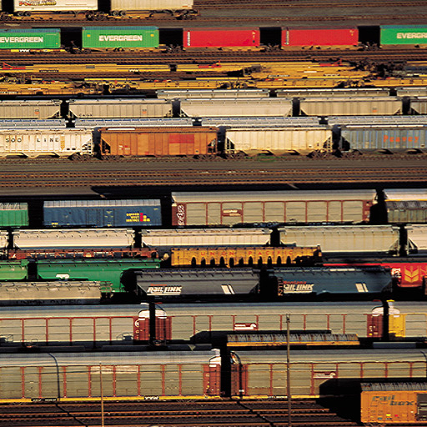
Original Image + Up Difference
image I
I+(I∗h) = I+(I∗ )

Slide 56


Horizontal Edges (D+U Diffs)
power spectrum of I∗h = I∗
I∗h = I∗

Slide 57

Original Image + Horizontal Edges
image I
I+(I∗h) = I+(I∗ )

Slide 58

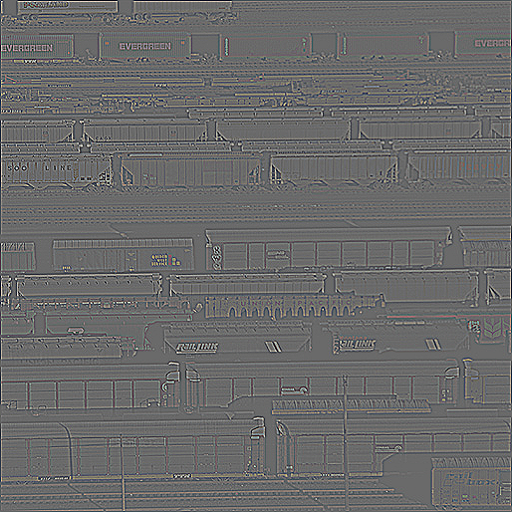
Horiz. + Vert. Edges (L+R+D+U Diffs)
power spectrum of I∗h = I∗
I∗h = I∗

Slide 59

Original Image + Horiz. + Vert. Edges
original
sharpened

Slide 60
Original Image + Horiz. + Vert. Edges
sharpened
original

Slide 61
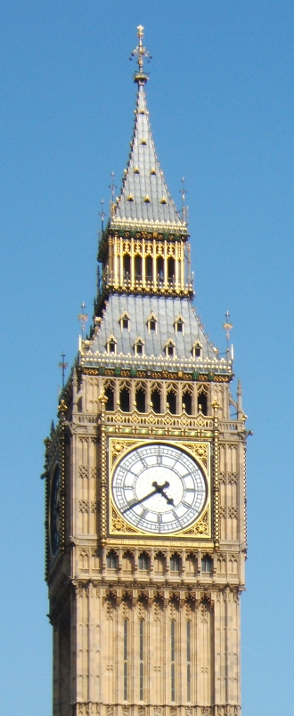
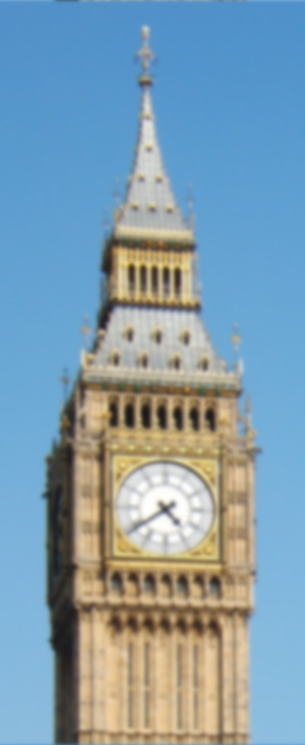
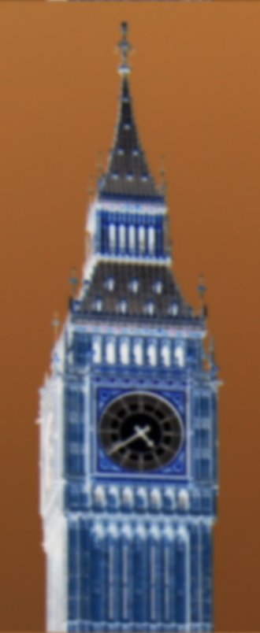
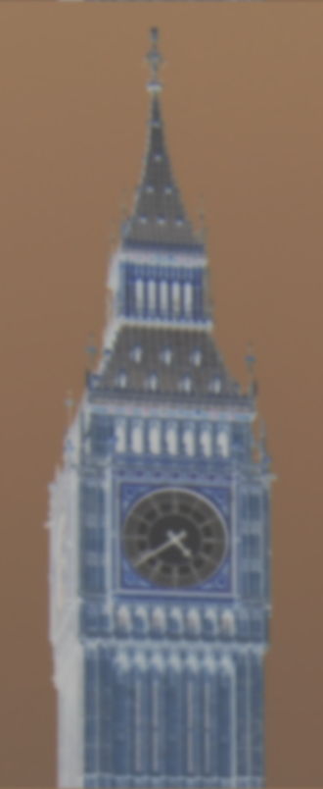
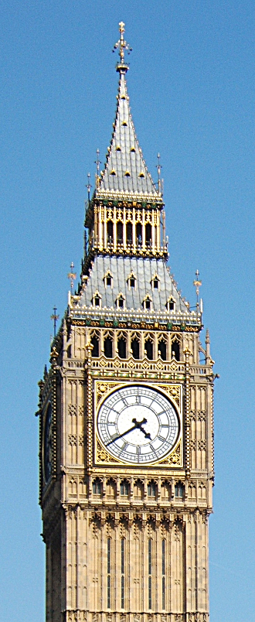
Unsharp Masking
is a film-photography darkroom technique for sharpening an image. A blurred copy of the photonegative is contrast reduced and used to mask the original image.
original
blurred
negative
lo-contrast
USM
+
=

Slide 62
Sharpening Through Blurring: Unsharp Masking
Let I be an image.
Let G_{σ} be a Gaussian convolution mask.
Then J = I * G_{σ} is a blurred image and K = I – J contains all the high spatial frequencies from I.
Define:
U = (1+α) K + J = α K + I,
where, typically 0 < α < 2.
U is called the unsharp masking of image I.
Often, the control, α, is given as a percent value.
Then the formula is (α/100)*K+I.

Slide 63
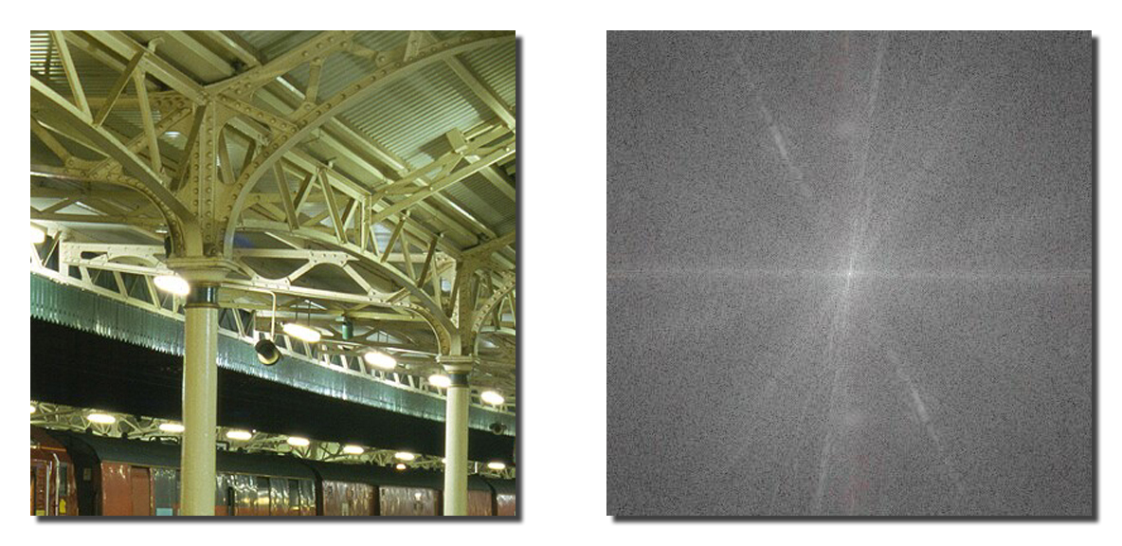
Sharpening Through Blurring: Unsharp Masking
original image
log power spectrum

Slide 64
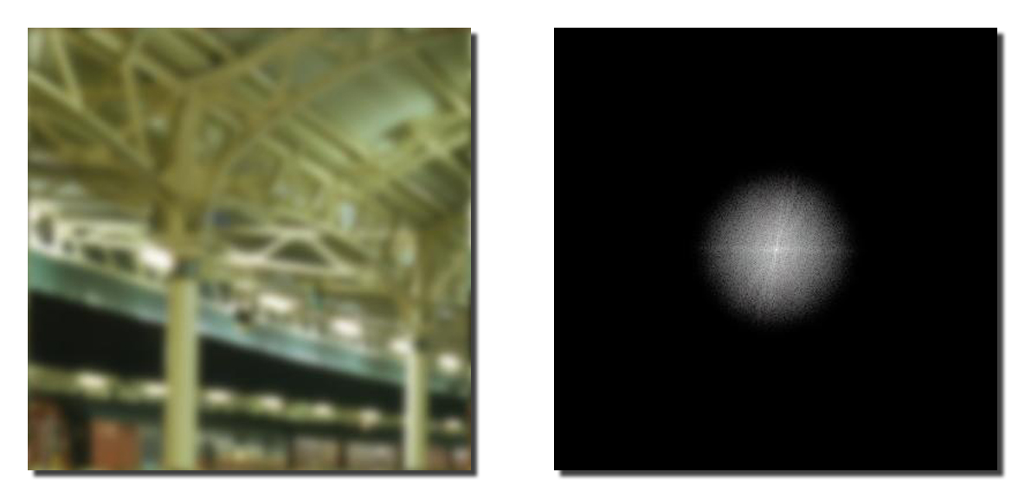
Sharpening Through Blurring: Unsharp Masking
Gaussian blur σ=4
log power spectrum

Slide 65
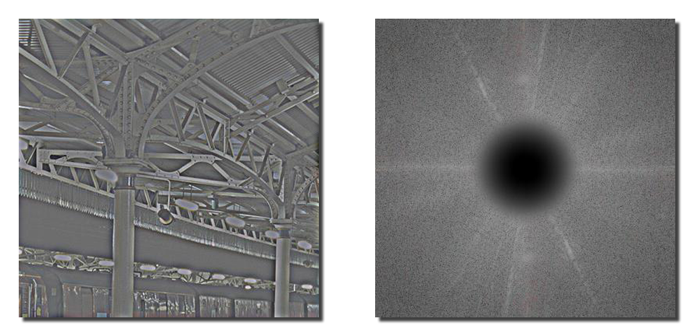
Sharpening Through Blurring: Unsharp Masking
original minus Gaussian blur
log power spectrum

Slide 66

Sharpening Through Blurring: Unsharp Masking
unsharp masked image
log power spectrum

Slide 67
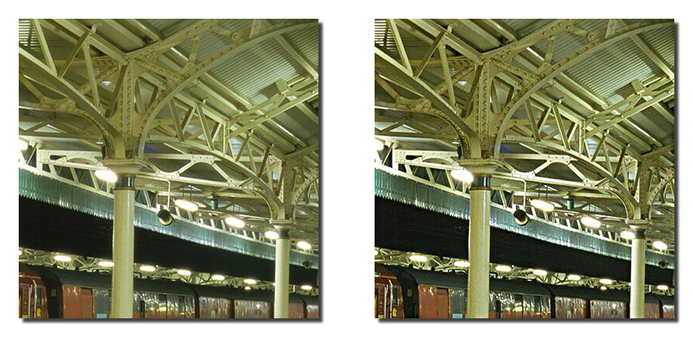
Sharpening Through Blurring: Unsharp Masking
original image
unsharp masked image

Slide 68
Sharpening above a Specific Scale.
An image is sharpened by taking a linear combination of the image and a highpass filtered version of itself. The scale of the sharpening can be controlled via the cutoff of the HPF. In the following examples the image has been sharpened via
where g is a 2D Gaussian with σ ∈ {1, 2, 4, 8, 16, 32, 64, 128, 256} and α is a scale factor, usually in (0,2). After the computation, each image was histogram matched to I.

Slide 69
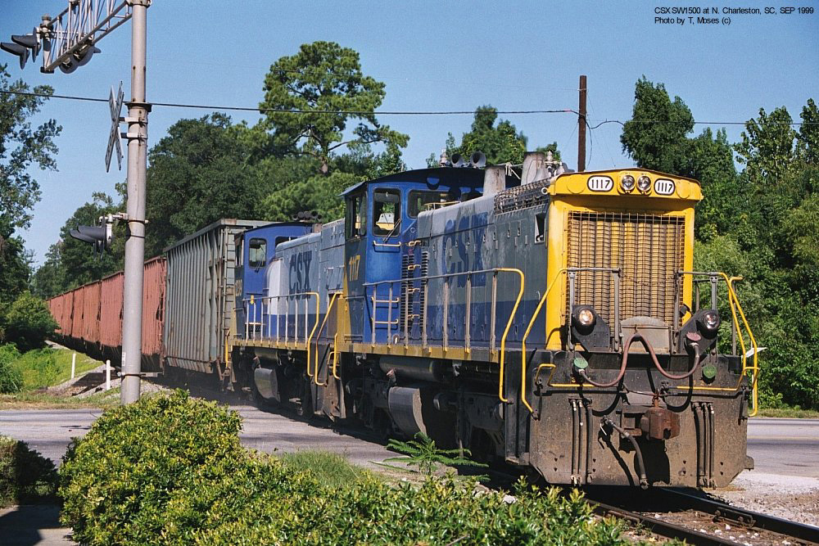
Sharpening above a Specific Scale
σ₀ = 0
Original Image

Slide 70
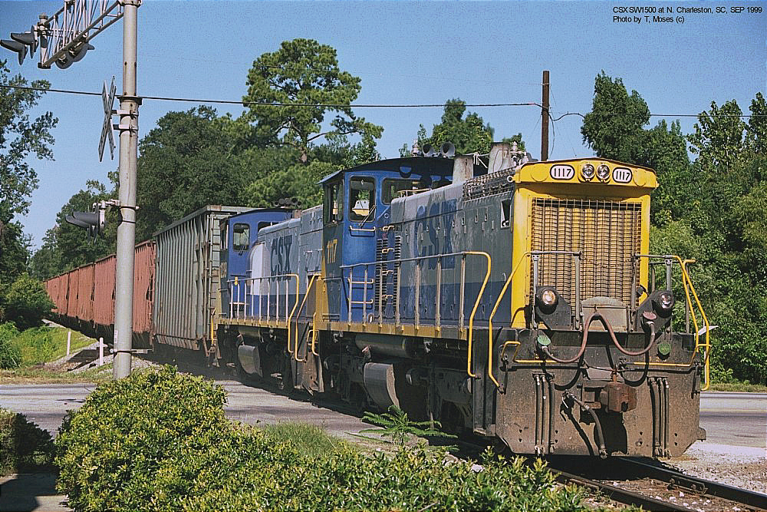
Sharpening above a Specific Scale
σ₀ = 1, α=1

Slide 71

Sharpening above a Specific Scale
σ₀ = 2, α=1

Slide 72
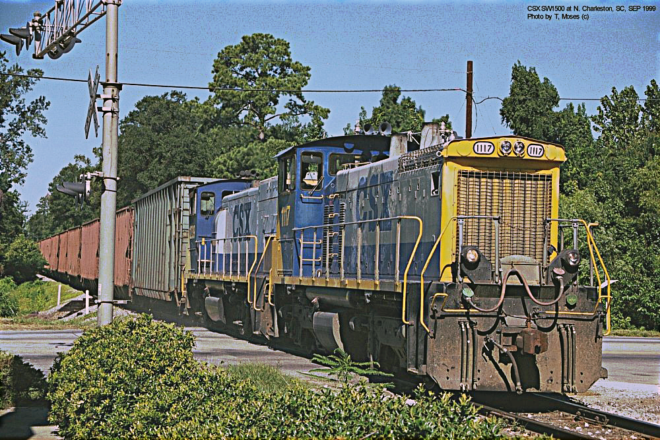
Sharpening above a Specific Scale
σ₀ = 4, α=1

Slide 73

Sharpening above a Specific Scale
σ₀ = 8, α=1

Slide 74
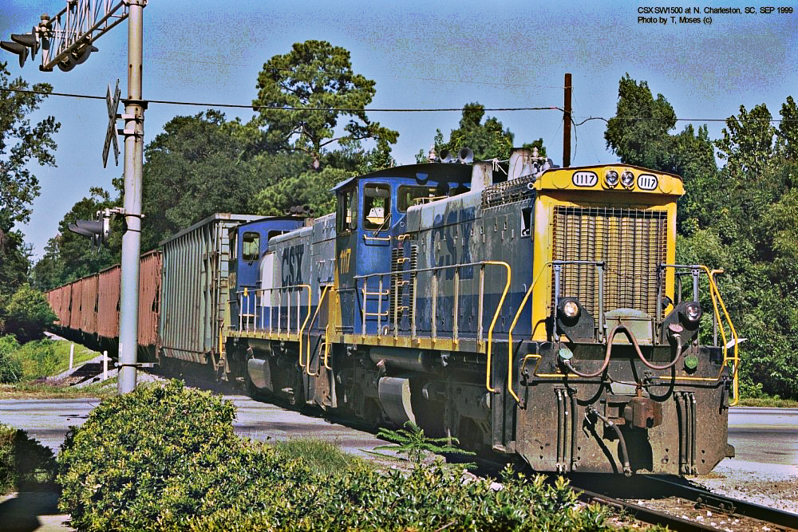
Sharpening above a Specific Scale
σ₀ = 16, α=1

Slide 75

Sharpening above a Specific Scale
σ₀ = 32, α=1

Slide 76
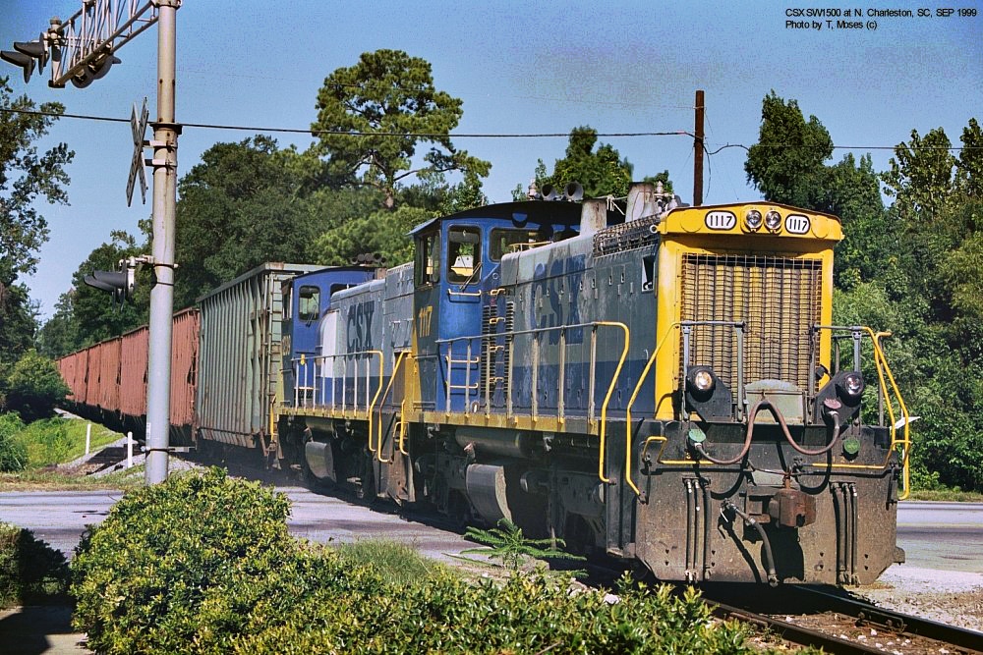
Sharpening above a Specific Scale
σ₀ = 64, α=1

Slide 77

Sharpening above a Specific Scale
σ₀ = 128, α=1

Slide 78

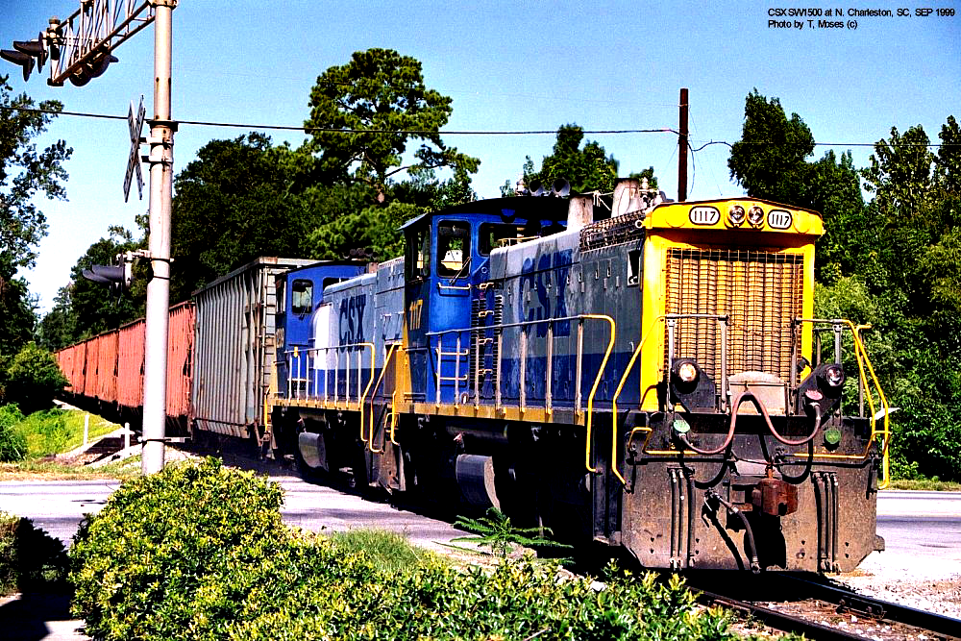
Sharpening above a Specific Scale
σ₀ = 256, α=1

Slide 79
Sharpening above a Specific Scale
σ₀ = 0
Original Image

Slide 80
Emphasizing a Specific Pass Band.
An image can be bandpass filtered by subtracting two differently Gaussian filtered copies of it. That specific band can be emphasized in the image by adding it back to the image. In the following examples the image has been emphasized via
where σ₀, σ₁ ∈ {1, 2, 4, 8, 16, 32, 64, 128, 256} and α is a scale factor, usually in (0,2). After the computation, each image was histogram matched to I.

Slide 81
Emphasizing a Specific Pass Band
(σ₁,σ₀ ) = (1,0), α=1

Slide 82

Emphasizing a Specific Pass Band
(σ₁,σ₀ ) = (2,1), α=1

Slide 83

Emphasizing a Specific Pass Band
(σ₁,σ₀ ) = (4,2), α=1

Slide 84

Emphasizing a Specific Pass Band
(σ₁,σ₀ ) = (8,4), α=1

Slide 85

Emphasizing a Specific Pass Band
(σ₁,σ₀ ) = (16,8), α=1

Slide 86
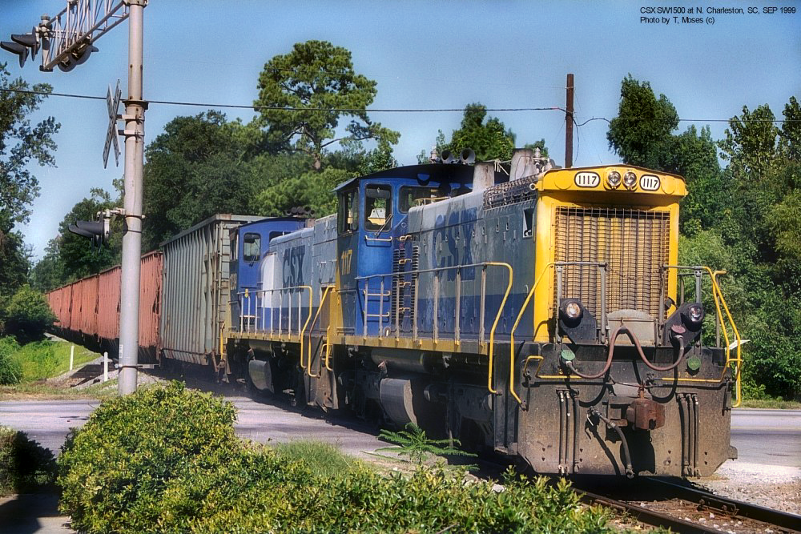
Emphasizing a Specific Pass Band
(σ₁,σ₀ ) = (32,16), α=1

Slide 87

Emphasizing a Specific Pass Band
(σ₁,σ₀ ) = (64,32), α=1

Slide 88

Emphasizing a Specific Pass Band
(σ₁,σ₀ ) = (128,64), α=1

Slide 89

Emphasizing a Specific Pass Band
(σ₁,σ₀ ) = (256,128), α=1

Slide 90
Emphasizing a Specific Pass Band
σ₀ = 0
Original Image

Slide 91
Noise Enhancement: the Problem with Sharpening
Noise occurs in every natural imaging device
Quantum effects in CCD arrays
Random distribution of silver halide grains in film
Neuronal noise in the retina
Spatially independent noise
The noise in one sensor has no effect on that in its neighbors
⇒ the autocorrelation of the signal is an impulse at the origin
The chances of getting repeated patterns of any frequency are virtually nil
⇒ the frequency spectrum of the noise is flat
Recall: Autocorrelation = inverse Fourier transform of power spectrum; Fourier transform of an impulse at (0,0) is a constant.

Slide 92
Noise Enhancement: the Problem with Sharpening
The spectra of most natural images fall-off toward the high frequencies.
IID noise has a flat spectrum.
Therefore, at some relatively high frequency (HF) the energy in the noise is greater than that in the uncorrupted image.
Sharpening multiplies the FT of the image by u and v (or by linear combinations of them) which, at HF, increases the noise more than the uncorrupted image.

Slide 93



Effects of Noise on Linear Enhancement of HF
original image
noisy image

Slide 94


Effects of Noise on Linear Enhancement of HF
HF enhanced original
HF enhanced noisy image

Slide 95


Effects of Noise on Linear Enhancement of HF
original image
noisy image

Slide 96


Effects of Noise on Linear Enhancement of HF
HF enhanced original
HF enhanced noisy image

Slide 97
Effects of Noise on Linear Enhancement of HF
original image
HF enhanced original

Slide 98
Effects of Noise on Linear Enhancement of HF
noisy image
HF enhanced noisy image

